Slide 1


We’re really looking forward to taking the children away for an exciting few days of adventure, activities and new experiences!
📱 Before we get started…
Feel free to scan the QR code to explore the Hilltop website and find out more about where the children will be staying and the activities that they might be taking part in! All will be revealed soon!
🔍 There’s also a good video at the bottom of the ‘Activities’ page under the ‘School’ tab. Volume down though, please.
🌟 Adventure • Friendship • Independence • Memories 🌟
Notes:
Good evening everyone, and welcome to our residential information evening. Firstly, thank you all for coming. I know evenings can be busy, so we really appreciate you taking the time to be here.
The purpose of tonight is really quite simple: **we want you to feel as informed, reassured and prepared as possible before the children head off.**
We know that for some children, this might be their **first time away from home without their family**, and we completely understand that this can bring a mixture of excitement, nerves and, occasionally, a few *“Are you sure they’re going to be alright?”* questions from parents! And actually, those questions are exactly what tonight is for.
We’ll talk you through **where the children are going, what they’ll be doing, what they need to bring, meals, medication, behaviour and expectations, communication, safeguarding, and what happens in an emergency**.
We’ll also hopefully reassure you that this isn’t just about going away and doing lots of exciting activities. It’s about giving the children the opportunity to **develop independence, build friendships, challenge themselves, try new things and create memories that they’ll hopefully talk about for a very long time.**
We also want this to be a positive experience for you as parents. We appreciate that sending your child away can feel like a much bigger deal for the adults than it sometimes does for the children!
By the end of the presentation, our hope is that you’ll know exactly what to expect — and, more importantly, that you’ll be feeling **excited rather than anxious** about what lies ahead.
So, thank you again for coming. We’re really looking forward to taking the children to **Hilltop**, giving them a fantastic experience and, hopefully, coming back with lots of stories, photographs and memories — and **all of the children we took with us!**

Slide 2
🚌 Travel Arrangements 🚌
Monday 21st September 2026
Children should arrive at school and go to the Main Hall by 8:15am.
We will be getting ready to leave school shortly after 9:00am.
The coach will be parked at the bus stop on Hattons Park. If parents/carers would like to wave the children off, please wait at the bus stop rather than coming into the school grounds. This will help us to avoid additional pedestrian traffic around school in the morning.
🕦 Arrival at Hilltop
We are expecting to arrive at Hilltop at approximately 11:30 am. Once we arrive, children will have their packed lunch before we begin the activities.
🥪 Packed Lunch
Please provide a packed lunch for the journey. Please put the lunch in a plastic bag so that any rubbish can easily be disposed of afterwards.
Please follow our usual healthy-school packed lunch expectations:
  ❌ No sweets
  ❌ No fizzy drinks
  ❌ No glass bottles
  ✅ A refillable plastic water bottle (Children can keep their refillable water bottle with them throughout the trip and refill it as needed.)

Slide 3
🚌 Travel Arrangements 🚌
📚 Keeping Busy on the Coach
The journey is quite a long one, so children may bring a few small things to keep themselves occupied, such as:
  A book
  A notebook and pens/pencils
  A small pack of cards
Please do not bring any electronic devices.
We want the journey to be relaxed and enjoyable, but also safe and manageable for everyone.

Slide 4
👕 Clothing & Kit 👕
Hilltop is an outdoor activity centre, so please make sure children bring clothing that is comfortable, practical and suitable for getting muddy and wet! Please do not send children in their best or favourite clothes — things may get dirty during activities.
👟 Footwear
Children will need suitable outdoor footwear for activities, such as trainers.
Sliders, Crocs and similar open footwear must NOT be worn for activities as they are not suitable or safe for outdoor activities.
However, sliders or Crocs can be brought for wearing inside the dorms during downtime.
🎒 What to Pack
  🛏️ Sleeping bag and pillow
  👟 Indoor shoes
  👟 Outdoor shoes/trainers
  🧥 Waterproof coat/jacket
  👕 Layers of clothing – jogging bottoms, sports clothing, leggings, T-shirts, jumpers etc.
  🧼 Wash bag and toiletries
  🛁 Towel
  🗑️ Bin liner/Sack for dirty or wet clothing
  👚 A few spare changes of clothes in case clothes become wet, muddy or there are any accidents
🏷️ PLEASE LABEL EVERYTHING!

Slide 5
🚫 Please Do Not Bring 🚫
📱 Mobile phones
🎮 Games consoles
💻 Electronic gadgets/devices
💍 Jewellery
🧴 Aerosols or aerosol deodorant
💨 Hair dryers
🍬 Snacks, Sweets, Chewing Gum
💷 Money
🌰 Nut products (Tree nuts are on site)

Slide 6
💊 Medication 💊
If your child takes prescribed medication or uses an inhaler, please complete the appropriate medication consent form with as much detail as possible.
📋 Bring the completed form and medication with you on the morning of the trip in a labelled container.
🤢 If your child requires non-prescribed medication, such as travel-sickness tablets, please complete the appropriate consent form for this too.
🔒 All medication will be collected before we leave and safely stored in the medication cupboard in the staff area throughout the trip.

Slide 7
⭐ Staffing ⭐
Mr Thompson
Mrs Griffiths
Mrs Monk
Mrs Shefford
Mrs Drake
Miss Newton
Miss Hagger

Slide 8
Once we arrive at Hilltop, there will be a few things to get sorted before the fun begins!
  🛏️ Room allocations: We are staying at Sea View House, but you will find out which room you are staying in and who you will be sharing with when you arrive. No bedrooms are larger than 8, and rooms are en-suite or nearby.
  🎒 Unpack: Once you have found your room, you will have some time to unpack and get settled in.
  📋 Hilltop expectations: The Hilltop staff will then talk everyone through the rules, routines and expectations for the trip.
  👥 Activity groups: You will find out which activity group you are in during this the briefing from Hilltop staff.

Slide 9
  🧗 Activities 🧗
  🪢 High Ropes
  ⚡ Big Zipper
  🏹 Archery
  🪂 Super Swing
  🚵 Mountain Bikes
  💦 Rock Pool
  Alongside our organised activities, we will also have access to:
  🎲 Games Room
  📺 TV & Chill Room
  🏠 Communal Areas for relaxing and spending time together
  There will be opportunities throughout the trip to relax, socialise and enjoy some downtime between activities.

Slide 10
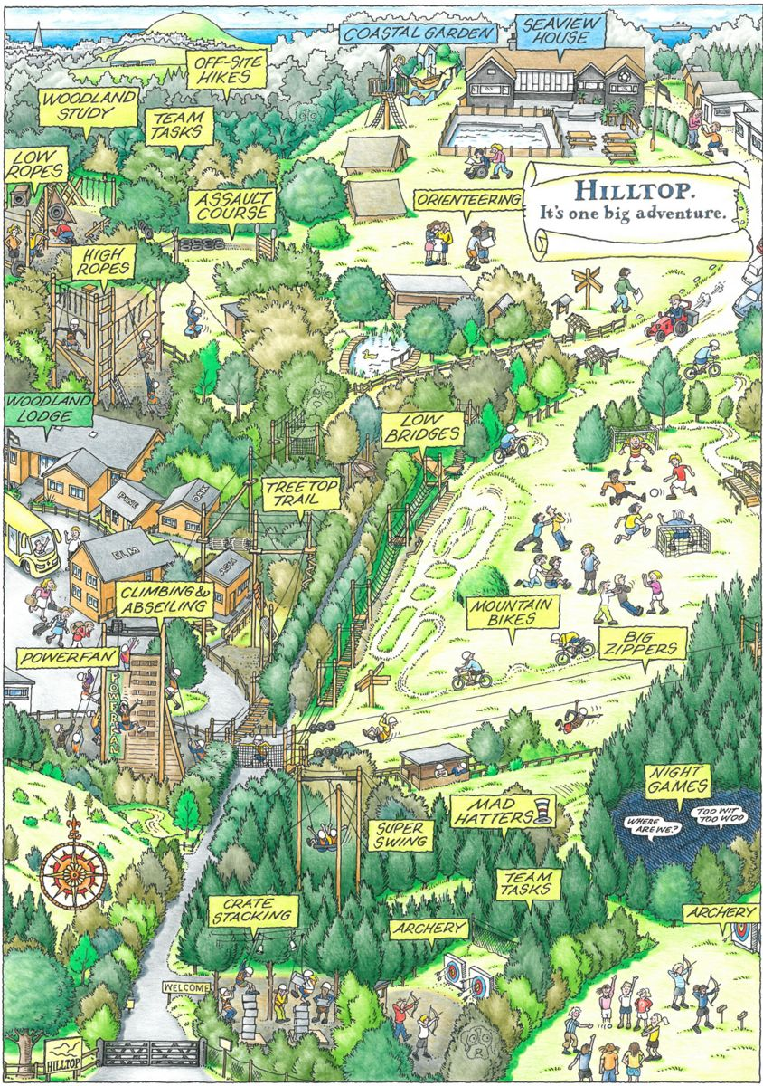

Slide 11

Food and drink

Slide 12
🚨 Emergencies & Contact Arrangements 🚨
📞 Mr Brooks will be the main parent/carer point of contact, as he is unlikely to be attending the residential. In the first instance, please contact the school office, who will be able to pass on messages and liaise with staff at the venue where necessary.
🏫 The children will also be made aware of the arrangements and will know which members of staff they can speak to should they need help or support.
📢 We will keep parents/carers updated throughout the trip through our usual school communication channels.
🚨 If an emergency occurs, parents/carers will be contacted directly by the school using the contact details we have on record. Families must be on call 24/7.

Slide 13
🌟 Behaviour & Expectations 🌟
Following our 6 R’s and school values, we are all representing Hatton Park Primary School throughout our stay.
🤝 We expect everyone to show respect and kindness towards:
👩‍🏫 Hatton Park staff
🏕️ Hilltop staff and activity leaders
👫 Each other
🏠 Our accommodation
🎒 Equipment and facilities we are trusted to use
👂 Listening carefully and following instructions is VITAL to keeping ourselves and others safe, as well as making sure everyone has a fun, positive and enjoyable experience.
⭐ Remember: we are representing Hatton Park - make us proud!

Slide 14


